Slide 1
Mind Anamorphosis
Michael McMahon
Toby Steele
Paul Gaffney
11/06/2017
Hack the Brain – Dublin Science Gallery

Slide 2
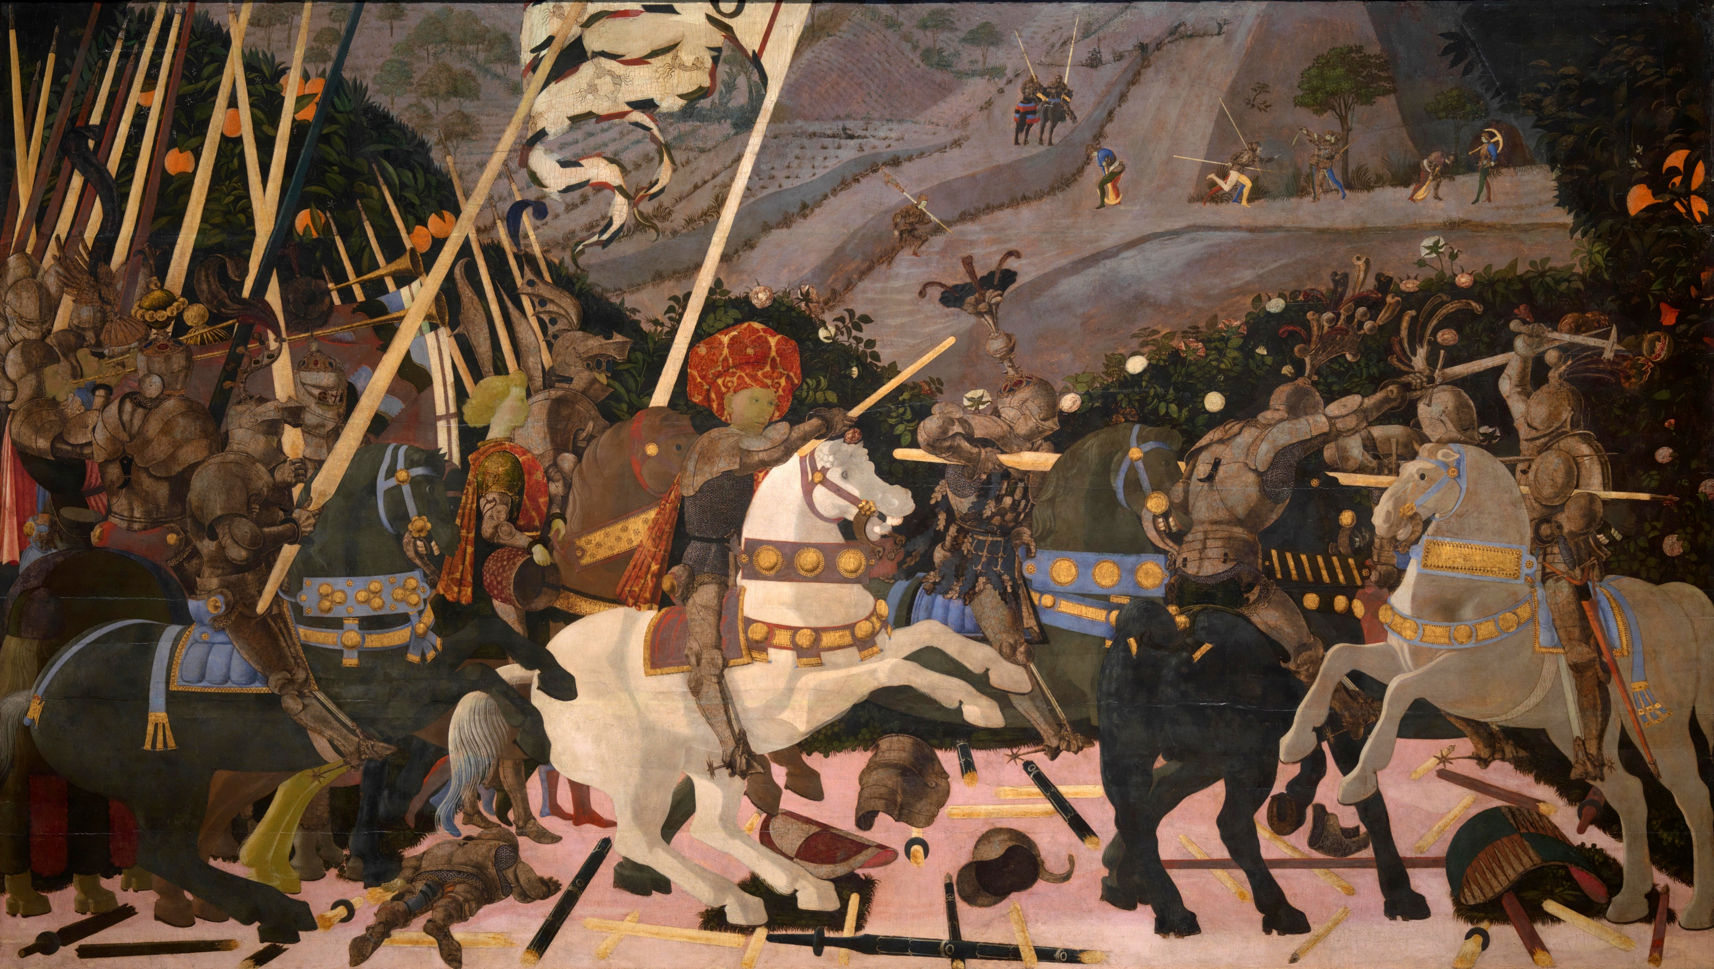
Over 500 years ago, Paolo Uccello created The Battle of San Romano revealing a development in linear perspective which was so shocking Lorenzo Medici stole.
Fig 1. Niccolò Mauruzi da Tolentino at the Battle of San Romano (probably c.?1438–1440), egg tempera with walnut oil and linseed oil on poplar, 182 × 320 cm, National Gallery, London.

Slide 3
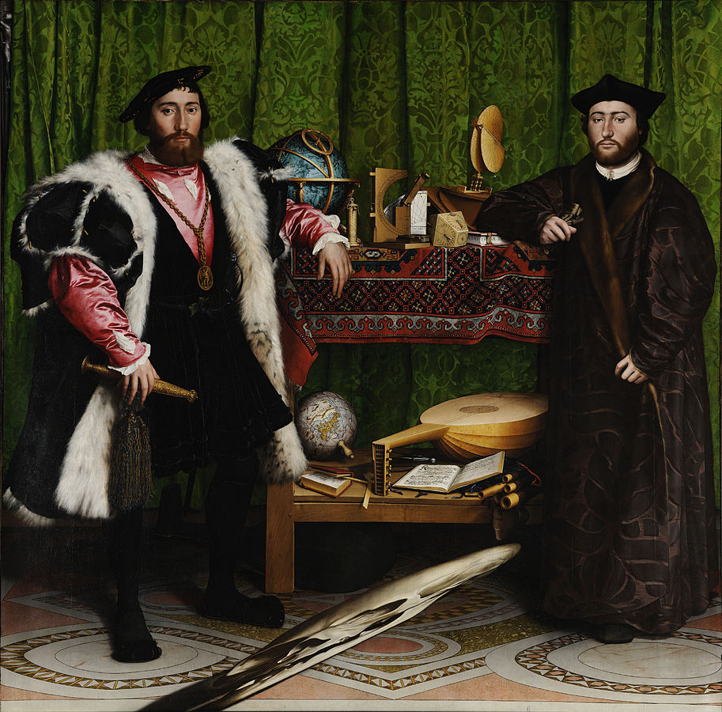
Nearly 100 years later Hans Holbein the Younger created The Ambassadors (1533), using a technique developed by Leonardo da Vinci to add a distorted skull in anamorphic perspective as wonderful example of memento mori.
Fig 2. Double Portrait of Jean de Dinteville and Georges de Selve ("The Ambassadors"), 1533. Oil and tempera on oak, National Gallery, London.

Slide 4
Anamorphosis is a distorted projection or perspective requiring the viewer to use special devices or occupy a specific vantage point (or both) to reconstitute the image.
Anamorphosis plays havoc with elements and principles; instead of reducing forms to their visible limits, it projects them outside themselves and distorts them so that when viewed for a certain point or through a device they return to normal
Anamorphosis creates a poetry of abstraction, optical illusion and a philosophy of false reality.

Slide 5
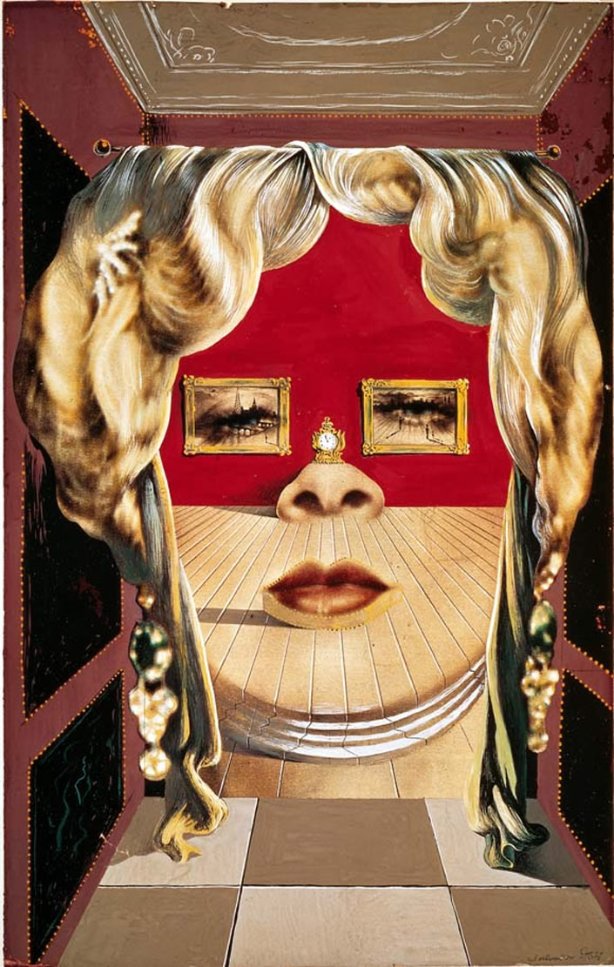
Salvador Dalí for example used Anamorphism in his paintings and installations with the 3D anamorphic installation with furniture that looks like the face of Mae West probably the most famous.
Fig 3. “Il volto di Mae West,” (original painting; 1934-35) by/© Salvador Dali. Bottom: “Gala Contemplating the Mediterranean Sea Which at 20 Meters Becomes The Portrait of Abraham Lincoln” (1976) by Dali.

Slide 6
A new type of Anamorphosis - a mind Anamorphosis.
Virtual reality (VR) art allows a participant to experience disembodied presence in an immaterial, abstract space and when coupled with Brain Computer Interface it has the potential to allow a person to affect their virtual surrounding using their thoughts. We envisage the participant inside an immersive dreamscape VR environment, where the content of the virtual environment, visual, aural and motion can be controlled by, and responds to, the persons imagined movement.
The focus will be on utilizing two waves in the alpha and beta range in primary sensorimotor cortex indicating motor intention or motor imagery of different body parts. The Mu rhythm which in the alpha range 7.5 to 12.5 Hz and the sensorimotor rhythm (SMR) in the range of 13 to 15 Hz both of which are dominant during rest but desynchronized when an individual is planning, executing, and imagining body movements.

Slide 7
Equipment
We will be used an g.tec EEG cap and electrodes, Open BCI, Openvibe, the Unreal Game Engine and a VR DK Oculus Rift.
Repository
https://github.com/HackTheBrain/MindAnamorphosis
Ethical considerations
No PII data will be collected
Permission will be requested before any EEG data is recorded
All participant data will be destroyed after the hackathon

Slide 8
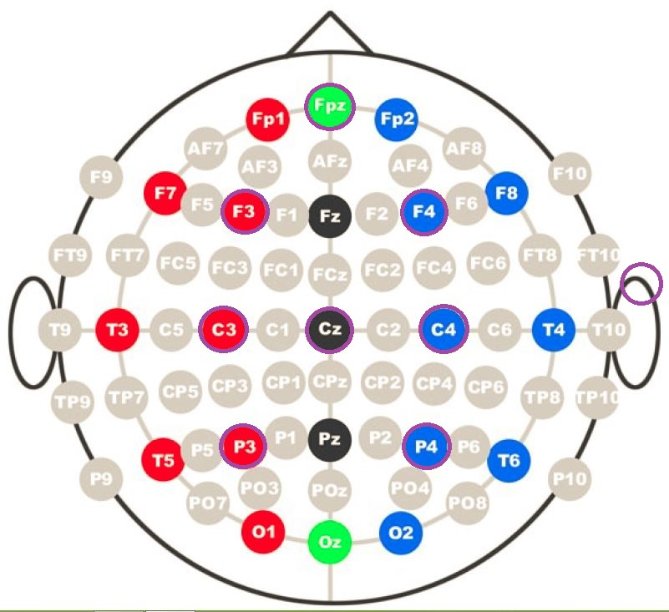
Electrodes were positioned at: FC3, Fz, FC4, C3, Cz, C4, P3, Pz, P4, PO7, Oz, PO8.

Slide 9
Signal Monitoring: Scenario used to check the signal quality of the acquisition device.
Acquisition: Acquire some data in order to train the classifier that will discriminate Right and Left hand movements.
Train: Computes Common Spatial Pattern to produce a spatial filter that maximizes the diff between the signal of the two classes.
Classifier Trainer: Trains a Linear Discriminant Analysis classifier based on the previous acquisition session.
BCI VR Controller: real-time feedback through Unreal VR using the trained LDA classifier

Slide 10
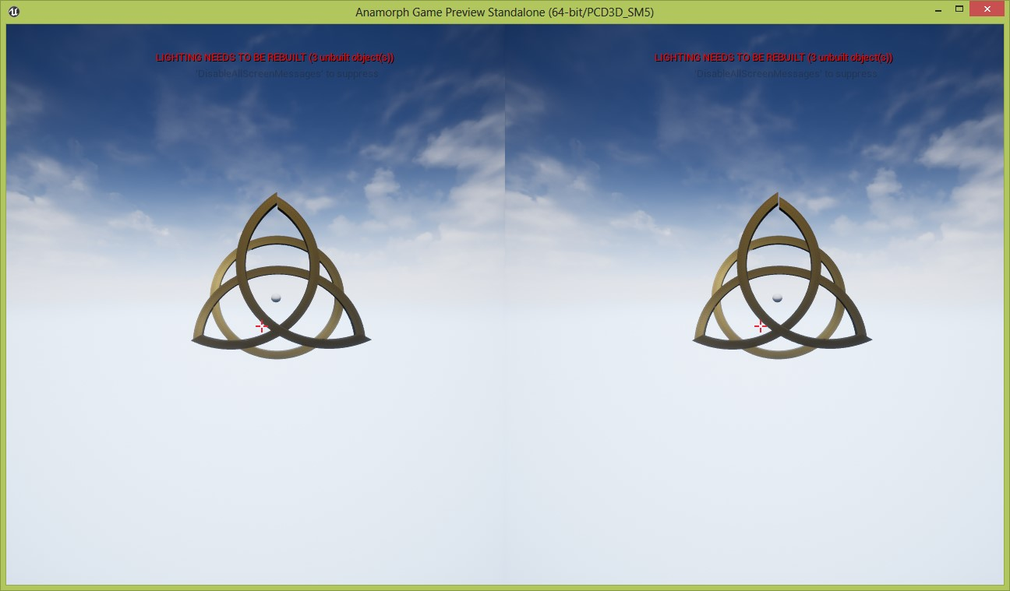
Start controlling the VR anamorphic object in Unreal using brain waves

Slide 11
Future Work
Continue to refine the scenarios and filters
Add further degrees of motion for other inputs
Work with Visual Artists, Sculptures and Game Designers to create more anamorphic VR Art

